Slide 1
Multithreading

Slide 2
Multithreading is a Java feature that allows concurrent execution of two or more parts of a program for maximum utilization of CPU. Each part of such program is called a thread. So, threads are light-weight processes within a process.

Slide 3
Example-
Generally you will be eating dinner while watching TV. At the same time, you may be talking to your mother to get some more eatables. Now, you are doing three different tasks in parallel. This we call in computers as multitasking achieved through multithreading.
To achieve multiple tasks parallel, Programmer uses threads. Multithreading gives Java the ability to achieve multiple tasks in parallel. One task does not wait for another to complete. That is, without completing one task, another task can start and also can execute.

Slide 4
Example-
Another familiar example is a browser that starts rendering a web page while it is still downloading the rest of page.

Slide 5
Example-
As humans, we are good at multitasking. Our brains are capable of shifting the priorities between these tasks and still be able to perform all of them together with ease.
In the same fashion, computers are designed to perform multiple operations in parallel so that different PROCESSES can execute in the system. Just as we do, we are able to play the music in our computer and still be able to work on a document.
Multithreading in Java gives the ability to execute code by different threads to perform tasks in parallel or as a separate task without waiting for other to complete.

Slide 6
A thread is a lightweight subprocess, the smallest unit of processing. It is a separate path of execution.
Threads are independent. If there occurs exception in one thread, it doesn't affect other threads. It uses a shared memory area.
As shown in the above figure, a thread is executed inside the process. There is context-switching between the threads. There can be multiple processes inside the OS, and one process can have multiple threads.

Slide 7
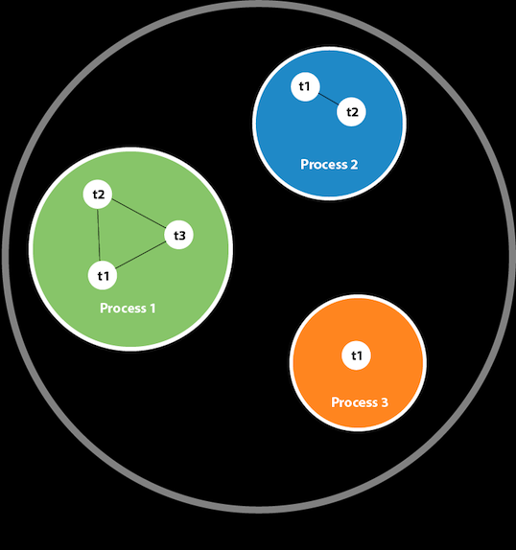

Slide 8
Threads can be created by using two mechanisms :
Extending the Thread class
Implementing the Runnable Interface

Slide 9
Thread creation by extending the Thread class
We create a class that extends the java.lang.Thread class. This class overrides the run() method available in the Thread class. A thread begins its life inside run() method. We create an object of our new class and call start() method to start the execution of a thread. Start() invokes the run() method on the Thread object.

Slide 10
class MultithreadingDemo extends Thread {
public void run()
{
try {
// Displaying the thread that is running
System.out.println(
"Thread " + Thread.currentThread().getId()
+ " is running");
}
catch (Exception e) {
// Throwing an exception
System.out.println("Exception is caught");
}
}
}
// Main Class
public class Multithread {
public static void main(String[] args)
{
int n = 8; // Number of threads
for (int i = 0; i < n; i++) {
MultithreadingDemo object
= new MultithreadingDemo();
object.start();
}
}
}

Slide 11
Thread creation by implementing the Runnable Interface
We create a new class which implements java.lang.Runnable interface and override run() method. Then we instantiate a Thread object and call start() method on this object.

Slide 12
// Java code for thread creation by implementing
// the Runnable Interface
class MultithreadingDemo implements Runnable {
public void run()
{
try {
// Displaying the thread that is running
System.out.println( "Thread " + Thread.currentThread().getId() + " is running");
}
catch (Exception e) {
// Throwing an exception
System.out.println("Exception is caught");
}
}
}
// Main Class
class Multithread {
public static void main(String[] args)
{
int n = 8; // Number of threads
for (int i = 0; i < n; i++) {
Thread object = new Thread(new MultithreadingDemo());
object.start();
}
}
}

Slide 13
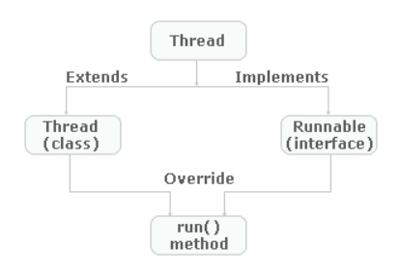

Slide 14
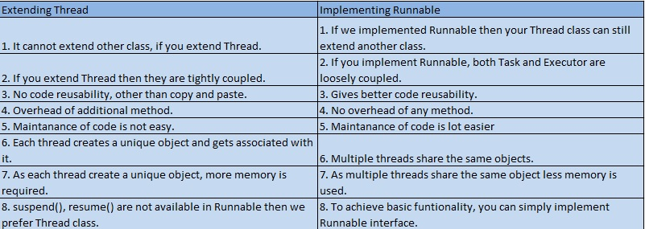

Slide 15
Life cycle of thread
Aka Thread states

Slide 16
A thread in Java at any point of time exists in any one of the following states. A thread lies only in one of the shown states at any instant:
New
Runnable
Blocked
Waiting
Timed Waiting
Terminated

Slide 17
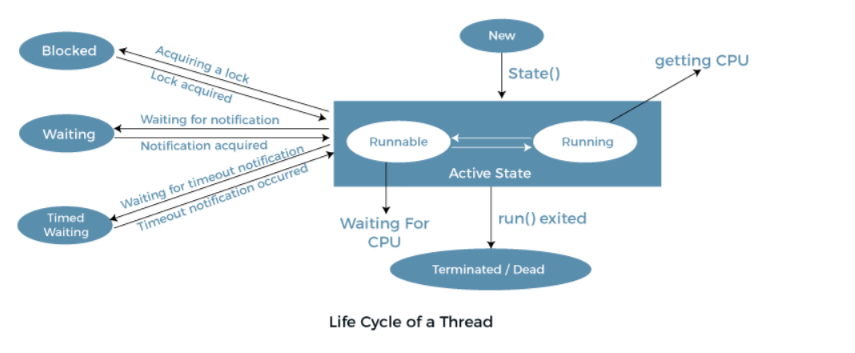

Slide 18
Explanation of Different Thread States
New: Whenever a new thread is created, it is always in the new state. For a thread in the new state, the code has not been run yet and thus has not begun its execution.
Active: When a thread invokes the start() method, it moves from the new state to the active state. The active state contains two states within it: one is runnable, and the other is running.

Slide 19
Eg-
public class ThreadState {
public void createNewThread() {
// Create a new thread
Thread thread = new Thread(() -> {});
// Print the thread's state (should be "NEW" at this point)
System.out.println("Thread state: " + thread.getState());
}
}
// Create a new instance of ThreadState
ThreadState threadState = new ThreadState();
// Call the createNewThread() method to create a new thread and print its state
threadState.createNewThread();

Slide 20
Runnable: A thread, that is ready to run is then moved to the runnable state. In the runnable state, the thread may be running or may be ready to run at any given instant of time. It is the duty of the thread scheduler to provide the thread time to run, i.e., moving the thread the running state. A program implementing multithreading acquires a fixed slice of time to each individual thread. Each and every thread runs for a short span of time and when that allocated time slice is over, the thread voluntarily gives up the CPU to the other thread, so that the other threads can also run for their slice of time. Whenever such a scenario occurs, all those threads that are willing to run, waiting for their turn to run, lie in the runnable state. In the runnable state, there is a queue where the threads lie.
Running: When the thread gets the CPU, it moves from the runnable to the running state. Generally, the most common change in the state of a thread is from runnable to running and again back to runnable.

Slide 21
Eg-
public class ThreadState {
public void createRunnableThread() {
// Create a new thread
Thread thread = new Thread(() -> {});
// Start the thread (this will transition it to the "RUNNABLE" state)
thread.start();
// Print the thread's state (should be "RUNNABLE" at this point)
System.out.println("Thread state: " + thread.getState());
}
}
// Create a new instance of ThreadState
ThreadState threadState = new ThreadState();
// Call the createRunnableThread() method to create a new thread, start it, and print its state
threadState.createRunnableThread();

Slide 22
Blocked or Waiting: Whenever a thread is inactive for a span of time (not permanently) then, either the thread is in the blocked state or is in the waiting state.
For example, a thread (let's say its name is A) may want to print some data from the printer. However, at the same time, the other thread (let's say its name is B) is using the printer to print some data. Therefore, thread A has to wait for thread B to use the printer. Thus, thread A is in the blocked state. A thread in the blocked state is unable to perform any execution and thus never consume any cycle of the Central Processing Unit (CPU). Hence, we can say that thread A remains idle until the thread scheduler reactivates thread A, which is in the waiting or blocked state.
When the main thread invokes the join() method then, it is said that the main thread is in the waiting state. The main thread then waits for the child threads to complete their tasks. When the child threads complete their job, a notification is sent to the main thread, which again moves the thread from waiting to the active state.
If there are a lot of threads in the waiting or blocked state, then it is the duty of the thread scheduler to determine which thread to choose and which one to reject, and the chosen thread is then given the opportunity to run.

Slide 23
public class ThreadState {
public void createBlockedThread() throws InterruptedException {
// Create two new threads, each running the Task object
Thread thread1 = new Thread(new Task());
Thread thread2 = new Thread(new Task());
// Start the first thread
thread1.start();
// Sleep for one second to give thread1 a chance to acquire the lock
Thread.sleep(1000);
// Start the second thread
thread2.start();
// Sleep for one second to give thread2 a chance to block
Thread.sleep(1000);
// Print the state of thread2 (should be "BLOCKED" at this point)
System.out.println("Thread2 state: " + thread2.getState());
// Exit the program
System.exit(0);
}
}
class Task implements Runnable {
@Override
public void run() {
performTask();
}
public static synchronized void performTask() {
while(true) {
// Thread1 will run forever, holding the lock, and preventing thread2 from executing
}
}
}
// Create a new instance of ThreadState
ThreadState threadState = new ThreadState();
// Call the createBlockedThread() method to create two threads, start them, and print the state of one of them
threadState.createBlockedThread();

Slide 24
public class ThreadState
{
public void createWaitingThread()
{
// Create a new thread and start it
Thread thread1 = new Thread(new Thread1Task());
thread1.start();
// Exit the program
System.exit(0);
}
}
class Thread1Task implements Runnable
{
@Override
public void run()
{
// Create a new thread and start it
Thread thread2 = new Thread(new Thread2Task());
thread2.start();
// Wait for thread2 to complete before continuing
try {
thread2.join();
} catch (InterruptedException e) {
e.printStackTrace();
}
// Thread1 is in waiting state until thread2 finishes execution
}
}
class Thread2Task implements Runnable
{
@Override
public void run()
{
try {
// Sleep for 2 seconds to simulate some work being done
Thread.sleep(2000);
} catch (InterruptedException e) {
e.printStackTrace();
}
// Thread2 finishes execution and thread1 continues execution
System.out.println("Thread1 State: " + thread1.getState());
}
}
ThreadState threadState = new ThreadState();
threadState.createWaitingThread();

Slide 25
Timed Waiting: Sometimes, waiting for leads to starvation. For example, a thread (its name is A) has entered the critical section of a code and is not willing to leave that critical section. In such a scenario, another thread (its name is B) has to wait forever, which leads to starvation. To avoid such scenario, a timed waiting state is given to thread B. Thus, thread lies in the waiting state for a specific span of time, and not forever. A real example of timed waiting is when we invoke the sleep() method on a specific thread. The sleep() method puts the thread in the timed wait state. After the time runs out, the thread wakes up and start its execution from when it has left earlier.

Slide 26
public class ThreadState
{
public void createTimedWaitingThread()
{
Thread thread = new Thread(() ->
{
// thread enters sleep state with a timeout period of 5 seconds
Thread.sleep(5000);
});
// TIMED_WAITING
System.out.println("Thread state: " + thread.getState());
}
}
// create instance of ThreadState and call createTimedWaitingThread method
ThreadState threadState = new ThreadState();
threadState.createTimedWaitingThread();

Slide 27
Terminated: A thread reaches the termination state because of the following reasons:
When a thread has finished its job, then it exists or terminates normally.
Abnormal termination: It occurs when some unusual events such as an unhandled exception or segmentation fault.
A terminated thread means the thread is no more in the system. In other words, the thread is dead, and there is no way one can respawn (active after kill) the dead thread.

Slide 28
public class ThreadState
{
public void createTerminatedThread()
{
Thread thread = new Thread(() -> {});
thread.start();
Thread.sleep(2000); // Sleep for 2 seconds to allow thread to finish execution
// TERMINATED
System.out.println("Thread state: " + thread.getState());
}
}
ThreadState threadState = new ThreadState();
threadState.createTerminatedThread();

Slide 29
Thread Scheduler in Java
A component of Java that decides which thread to run or execute and which thread to wait is called a thread scheduler in Java. In Java, a thread is only chosen by a thread scheduler if it is in the runnable state. However, if there is more than one thread in the runnable state, it is up to the thread scheduler to pick one of the threads and ignore the other ones. There are some criteria that decide which thread will execute first. There are two factors for scheduling a thread i.e. Priority and Time of arrival.
Priority: Priority of each thread lies between 1 to 10. If a thread has a higher priority, it means that thread has got a better chance of getting picked up by the thread scheduler.
Time of Arrival: Suppose two threads of the same priority enter the runnable state, then priority cannot be the factor to pick a thread from these two threads. In such a case, arrival time of thread is considered by the thread scheduler. A thread that arrived first gets the preference over the other threads.

Slide 30
First Come First Serve Scheduling:
In this scheduling algorithm, the scheduler picks the threads thar arrive first in the runnable queue. Observe the following table:
t1->0
t2->1
t3->2
t4->3
Thread t1 will be processed first, and Thread t4 will be processed last.

Slide 31
2. Time-slicing scheduling:
Usually, the First Come First Serve algorithm is non-preemptive, which is bad as it may lead to infinite blocking (also known as starvation). To avoid that, some time-slices are provided to the threads so that after some time, the running thread has to give up the CPU. Thus, the other waiting threads also get time to run their job.

Slide 32
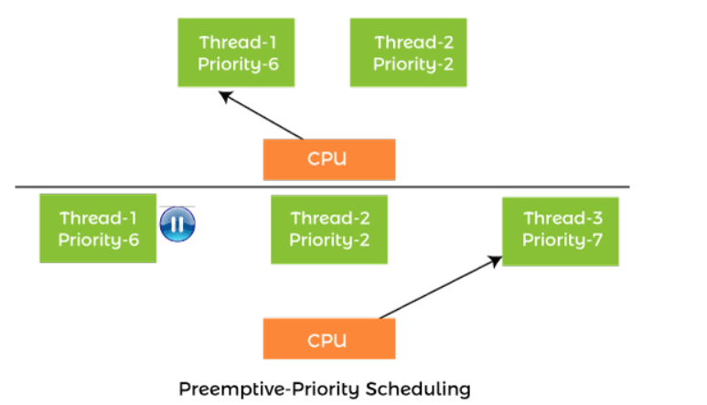
3. Preemptive-Priority Scheduling:

Slide 33
Suppose there are multiple threads available in the runnable state. The thread scheduler picks that thread that has the highest priority. Since the algorithm is also preemptive, therefore, time slices are also provided to the threads to avoid starvation. Thus, after some time, even if the highest priority thread has not completed its job, it has to release the CPU because of preemption.

Slide 34
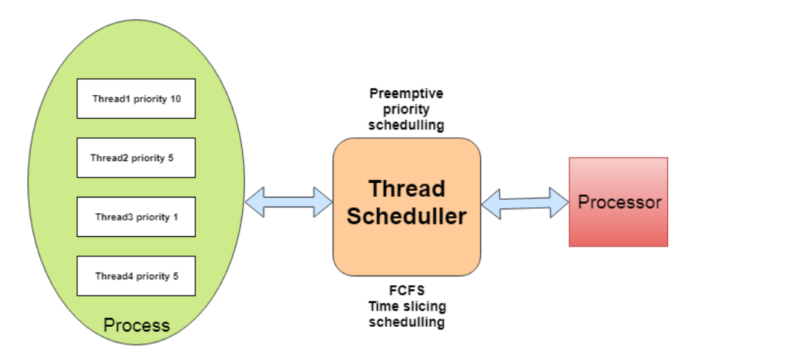
Working of Thread scheduler

Slide 35
Priority of a Thread (Thread Priority)
Each thread has a priority. Priorities are represented by a number between 1 and 10. In most cases, the thread scheduler schedules the threads according to their priority (known as preemptive scheduling). But it is not guaranteed because it depends on JVM specification that which scheduling it chooses.

Slide 36
3 constants defined in Thread class:
public static int MIN_PRIORITY
public static int NORM_PRIORITY
public static int MAX_PRIORITY
Default priority of a thread is 5 (NORM_PRIORITY). The value of MIN_PRIORITY is 1 and the value of MAX_PRIORITY is 10.

Slide 37
// Java program to demonstrate that a Child thread
// Getting Same Priority as Parent thread
// Importing all classes from java.lang package
import java.lang.*;
// Main class
// ThreadDemo
// Extending Thread classa
class Main extends Thread {
// Method 1
// run() method for the thread that is
// invoked as threads are started
public void run()
{
// Print statement
System.out.println("Inside run method");
}
// Method 2
// Main driver method
public static void main(String[] args)
{
// main thread priority is set to 6 now
Thread.currentThread().setPriority(6);
// Current thread is accessed
// using currentThread() method
// Print and display main thread priority
// using getPriority() method of Thread class
System.out.println(
"main thread priority : "
+ Thread.currentThread().getPriority());
// Creating a thread by creating object inside
// main()
GFG t1 = new GFG();
// t1 thread is child of main thread
// so t1 thread will also have priority 6
// Print and display priority of current thread
System.out.println("t1 thread priority : "
+ t1.getPriority());
}
}

Slide 38
Note-
If the value of the parameter newPriority of the method getPriority() goes out of the range (1 to 10), then we get the IllegalArgumentException.

Slide 39
The methods which are affected by the priorities:
yield():It gives a clue to the thread scheduler that it is ready to pause the execution when the yield() method is being called on the thread. The thread scheduler checks if there is any thread with the same or high priority than the current thread on which yield() method has called. If the scheduler finds any thread with the higher or same priority, then it will move the current thread to Ready/Runnable state and give processor to other thread, and if not, the current thread will keep executing.
sleep(): This method indicates the currently executing thread to sleep for the specified number of milliseconds so that another thread having time slice goes for the execution in the processor.
join(): This method is used to queue up a thread in execution. Once called on the thread, the current thread will wait till the calling thread completes its execution.

Slide 40
Eg- output of the three threads having the join() methods without using priorities:
Effect on the join() method by using the priorities:
class A extends Thread
{
int i=0;
public void run()
{
System.out.println("Thread A started");
while(i<4)
{
System.out.println("\t value of i in Thread A:"+i);
i++;
}
System.out.println("ThreadA finished");
}
}
class B extends Thread
{
public void run()
{int i=0;
System.out.println("Thread B started");
while(i<4)
{
System.out.println("\t value of i in Thread B:"+i);
i++;
}
System.out.println("ThreadB finished");
}
}
class C extends Thread
{
public void run()
{
int i=0;
System.out.println("Thread C started");
while(i<4)
{
System.out.println("\t value of i in Thread C"+i);
i++;
}
System.out.println("Thread C finished");
}
}
public class priority {
public static void main(String[] args) {
System.out.println("Main Thread started");
A a=new A();
B b=new B();
C c=new C();
a.start();
b.start();
c.start();
try
{
a.join();
b.join();
c.join();
}
catch(InterruptedException e)
{
e.printStackTrace();
}
}
}

Slide 41
Explanation:
1. ThreadA, ThreadB and ThreadC and the main thread have been created.
2. As first of all, join method call on ThreadA then on ThreadB and in last on ThreadC.
3. TheadB and ThreadC have to wait for ThreadA to complete its run method (execution of the thread).
4. ThreadC also waits for ThreadB to complete its execution so that it can start its job, which is assigned to it.
5. In last main thread is executed when all the user threads (ThreadA, ThreadB ThreadC) have finished their execution.

Slide 42
Eg- Effect of using the priorities in the above join() method programs
Effect of using the priorities in the above join() method programs:
class A extends Thread
{
int i=0;
public void run()
{
System.out.println("Thread A started");
while(i<4)
{
System.out.println("\t value of i in Thread A:"+i);
i++;
}
System.out.println("ThreadA finished");
}
}
class B extends Thread
{
public void run()
{int i=0;
System.out.println("Thread B started");
while(i<4)
{
System.out.println("\t value of i in Thread B:"+i);
i++;
}
System.out.println("ThreadB finished");
}
}
class C extends Thread
{
public void run()
{
int i=0;
System.out.println("Thread C started");
while(i<4)
{
System.out.println("\t value of i in Thread C"+i);
i++;
}
System.out.println("Thread C finished");
}
}
public class scheduller {
public static void main(String[] args) {
System.out.println("Main Thread started");
A a=new A();
B b=new B();
C c=new C();
b.setPriority(Thread.MAX_PRIORITY);
c.setPriority(Thread.NORM_PRIORITY);
a.setPriority(Thread.MIN_PRIORITY);
a.start();
b.start();
c.start();
try
{
a.join();
b.join();
c.join();
}
catch(InterruptedException e)
{
e.printStackTrace();
}
}
}

Slide 43
Explanation:
1. We have set the priorities of the threads in the above program.
2. ThreadB has MAX_PRIORITY, so thread scheduler gives first time slice to the ThreadB according to the maximum priorities.
3. ThreadC has NORM_PRIORITY, and ThreadA has MIN_PRIORITY, so the time slice has been given to the ThreadC before the ThreadA.
4. The activity of the join method will follow to each thread after watching its priorities.

Slide 44
Eg- Program having only the yield() method.
class MyThread extends Thread
{
public void run()
{
for(int i=0;i<5;i++)
System.out.println(Thread.currentThread().getName());
}
}
public class priorityyield {
public static void main(String s[])
{
MyThread t=new MyThread();
t.start();
for(int i=0;i<5;i++)
{
MyThread.yield();
System.out.println(Thread.currentThread().getName());
}
}
}

Slide 45
Explanation:
1. There are two threads Thread-0, and the main thread is created.
2. The Thread.yield() call in the main thread stack so it will be pre-empted from the Running state and send to the Runnable state.
3.Then next thread-0 (user thread) has taken time slice to complete its job.
4.when the main thread will get the time slice again then it will complete its remaining task

Slide 46
Eg- Effect of using the priority on the yield() method program
class MyThread extends Thread
{
public void run()
{
for(int i=0;i<5;i++)
System.out.println(Thread.currentThread().getName());
}
}
public class priorityyield {
public static void main(String s[])
{
MyThread t=new MyThread();
t.start();
t.setPriority(Thread.MIN_PRIORITY);
for(int i=0;i<5;i++)
{
MyThread.yield();
System.out.println(Thread.currentThread().getName());
}
}
}

Slide 47
Explanation:
1. The main thread has a higher priority than the thread-0, so the main thread takes time slice before the thread-0.
2. The yield() method will work according to the priorities given to the threads here.

Slide 48
Eg- Program having the only sleep() method
public class ThreadDemo implements Runnable
{
Thread t;
public void run()
{
for(int i=0;i<4;i++)
{
System.out.println(Thread.currentThread().getName()+" "+i);
try
{
Thread.sleep(10);
}
catch(Exception e)
{
e.printStackTrace();
}
}
}
public static void main(String[] s1)throws Exception {
Thread t1=new Thread(new ThreadDemo());
Thread tmain=Thread.currentThread();
t1.start();
t1.setName("MIN Thread");
t1.setPriority(Thread.MIN_PRIORITY);
Thread t2=new Thread(new ThreadDemo());
t2.setName("NORM Thread");
t2.start();
t2.setPriority(Thread.NORM_PRIORITY);
System.out.println(tmain.getName());
tmain.setPriority(Thread.MAX_PRIORITY);
}
}

Slide 49
Explanation:
1.As the main thread has MAX_PRIORITY. The first time slice will be given to it
2. Thread t2 has NORM_PRIORITY, so it will get time slice next.
3. Thread t1 has MIN_PRIORITY, so it will get the last time slice of the thread scheduler.
4. The thread will be affected by the sleep method. The thread goes to the sleep state then the time slice will be preempted by other threads.

Slide 50
Popular interview Question
Q: Can we start a thread twice?

Slide 51
No. After starting a thread, it can never be started again. If you does so, an IllegalThreadStateException is thrown. In such case, thread will run once but for second time, it will throw exception.

Slide 52
public class TestThreadTwice1 extends Thread{
public void run(){
System.out.println("running...");
}
public static void main(String args[]){
TestThreadTwice1 t1=new TestThreadTwice1();
t1.start();
t1.start();
}
}

Slide 53
What if we call Java run() method directly instead start() method?
Each thread starts in a separate call stack.
Invoking the run() method from the main thread, the run() method goes onto the current call stack rather than at the beginning of a new call stack.

Slide 54
Daemon Thread in Java
Daemon thread in Java is a service provider thread that provides services to the user thread. Its life depend on the mercy of user threads i.e. when all the user threads dies, JVM terminates this thread automatically.
There are many java daemon threads running automatically e.g. gc, finalizer etc.

Slide 55
Points to remember
It provides services to user threads for background supporting tasks. It has no role in life than to serve user threads.
Its life depends on user threads.
It is a low priority thread.

Slide 56
Why JVM terminates the daemon thread if there is no user thread?
The sole purpose of the daemon thread is that it provides services to user thread for background supporting task. If there is no user thread, why should JVM keep running this thread. That is why JVM terminates the daemon thread if there is no user thread.

Slide 57
Eg-
public class TestDaemonThread1 extends Thread{
public void run(){
if(Thread.currentThread().isDaemon()){//checking for daemon thread
System.out.println("daemon thread work");
}
else{
System.out.println("user thread work");
}
}
public static void main(String[] args){
TestDaemonThread1 t1=new TestDaemonThread1();//creating thread
TestDaemonThread1 t2=new TestDaemonThread1();
TestDaemonThread1 t3=new TestDaemonThread1();
t1.setDaemon(true);//now t1 is daemon thread
t1.start();//starting threads
t2.start();
t3.start();
}
}

Slide 58
Java garbage collection: What is it and how does it work?
Garbage collection is a key feature for developers who build and compile Java programs on a Java Virtual Machine, or JVM. Java objects are created on the heap, which is a section of memory dedicated to a program. When objects are no longer needed, the garbage collector finds and tracks these unused objects and deletes them to free up space. Without garbage collection, the heap would eventually run out of memory, leading to a runtime OutOfMemoryError.

Slide 59
Java garbage collection helps your Java environments and applications perform more efficiently. However, you can still potentially run into issues with automatic garbage collection, including poor application performance. While you can’t manually override automatic garbage collection, there are things you can do to optimize garbage collection in your application environment, such as changing the garbage collector you use, removing all references to unused Java objects, and using an application monitoring tool to optimize performance and detect issues as soon as they arise.

Slide 60
1) By nulling a reference:
Employee e=new Employee();
e=null;
2) By assigning a reference to another:
Employee e1=new Employee();
Employee e2=new Employee();
e1=e2;//now the first object referred by e1 is available for garbage collection
3) By anonymous object:
new Employee();

Slide 61
finalize() method
The finalize() method is invoked each time before the object is garbage collected. This method can be used to perform cleanup processing.
It is defined in Object class

Slide 62
gc() method
The gc() method is used to invoke the garbage collector to perform cleanup processing. The gc() is found in System and Runtime classes.

Slide 63
Note: Garbage collection is performed by a daemon thread called Garbage Collector(GC). This thread calls the finalize() method before object is garbage collected.

Slide 64
Eg-
public class TestGarbage1{
public void finalize(){System.out.println("object is garbage collected");}
public static void main(String args[]){
TestGarbage1 s1=new TestGarbage1();
TestGarbage1 s2=new TestGarbage1();
s1=null;
s2=null;
System.gc();
}
}

Slide 65
You can make objects inaccessible in the following ways:
Create an object inside a method. After methods are executed, all objects called within those methods become unreachable, which makes them eligible for garbage collection.
Nullify the reference variable. You can change a reference variable to NULL. As long as all references to an object are removed, that object will become unreachable, which lets the garbage collector know the object can be removed.
Reassign the reference variable. Instead of nullifying the reference variable, you can also reassign the reference to another object. Once again, as long as all references to an object are removed, either through making reference variables NULL or reassigning them, the object will become inaccessible, leading to it being removed during the garbage collection process.
Create an anonymous object. An anonymous object doesn’t have a reference, so the

Slide 66
Java Thread Pool
A thread pool reuses previously created threads to execute current tasks and offers a solution to the problem of thread cycle overhead and resource thrashing. Since the thread is already existing when the request arrives, the delay introduced by thread creation is eliminated, making the application more responsive.

Slide 67
Java thread pool manages the pool of worker threads. It contains a queue that keeps tasks waiting to get executed. We can use ThreadPoolExecutor to create thread pool in Java. Java thread pool manages the collection of Runnable threads. The worker threads execute Runnable threads from the queue. java.util.concurrent.Executors provide factory and support methods for java.util.concurrent.Executor interface to create the thread pool in java.

Slide 68
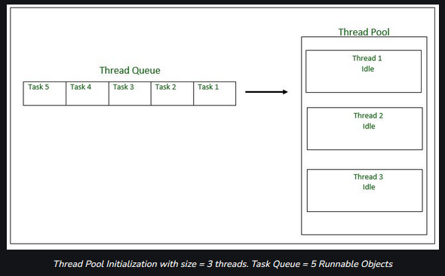

Slide 69
Executors is a utility class that also provides useful methods to work with ExecutorService, ScheduledExecutorService, ThreadFactory, and Callable classes through various factory methods.

Slide 70
Eg- ExecutorService Example(revi
import java.util.concurrent.ExecutorService;
import java.util.concurrent.Executors;
public class SimpleThreadPool {
public static void main(String[] args) {
ExecutorService executor = Executors.newFixedThreadPool(5);
for (int i = 0; i < 10; i++) {
Runnable worker = new WorkerThread("" + i);
executor.execute(worker);
}
executor.shutdown();
while (!executor.isTerminated()) {
}
System.out.println("Finished all threads");
}
}

Slide 71
In the above program, we are creating a fixed-size thread pool of 5 worker threads. Then we are submitting 10 jobs to this pool, since the pool size is 5, it will start working on 5 jobs and other jobs will be in wait state, as soon as one of the job is finished, another job from the wait queue will be picked up by worker thread and get’s executed.

Slide 72
Inter-thread Communication
Inter-thread communication or Co-operation is all about allowing synchronized threads to communicate with each other.
The Object class in java contains three final methods that allows threads to communicate about the lock status of a resource. These methods are wait(), notify() and notifyAll().

Slide 73
Before that let’s discuss Synchronization

Slide 74
Synchronization
Multi-threaded programs may often come to a situation where multiple threads try to access the same resources and finally produce erroneous and unforeseen results.
So it needs to be made sure by some synchronization method that only one thread can access the resource at a given point in time. Java provides a way of creating threads and synchronizing their tasks using synchronized blocks. Synchronized blocks in Java are marked with the synchronized keyword. A synchronized block in Java is synchronized on some object. All synchronized blocks synchronize on the same object can only have one thread executing inside them at a time. All other threads attempting to enter the synchronized block are blocked until the thread inside the synchronized block exits the block.

Slide 75
class Sender
{
public void send(String msg)
{
System.out.println("Sending\t" + msg );
try
{
Thread.sleep(1000);
}
catch (Exception e)
{
System.out.println("Thread interrupted.");
}
System.out.println("\n" + msg + "Sent");
}
}
// Class for send a message using Threads
class ThreadedSend extends Thread
{
private String msg;
Sender sender;
// Receives a message object and a string
// message to be sent
ThreadedSend(String m, Sender obj)
{
msg = m;
sender = obj;
}
public void run()
{
// Only one thread can send a message
// at a time.
synchronized(sender)
{
// synchronizing the send object
sender.send(msg);
}
}
}
// Driver class
class SyncDemo
{
public static void main(String args[])
{
Sender send = new Sender();
ThreadedSend S1 =
new ThreadedSend( " Hi " , send );
ThreadedSend S2 =
new ThreadedSend( " Bye " , send );
// Start two threads of ThreadedSend type
S1.start();
S2.start();
// wait for threads to end
try
{
S1.join();
S2.join();
}
catch(Exception e)
{
System.out.println("Interrupted");
}
}
}

Slide 76
Alternative approach
// An alternate implementation to demonstrate
// that we can use synchronized with method also.
class Sender {
public synchronized void send(String msg)
{
System.out.println("Sending\t" + msg);
try {
Thread.sleep(1000);
}
catch (Exception e) {
System.out.println("Thread interrupted.");
}
System.out.println("\n" + msg + "Sent");
}
}
The output is the same every time we run the program.

Slide 77
// that synchronized can be used with only a part of
// method
class Sender
{
public void send(String msg)
{
synchronized
{
System.out.println("Sending\t" + msg );
try
{
Thread.sleep(1000);
}
catch (Exception e)
{
System.out.println("Thread interrupted.");
}
System.out.println("\n" + msg + "Sent");
}
}
}

Slide 78
wait() Method
wait() method is a part of java.lang.Object class. When wait() method is called, the calling thread stops its execution until notify() or notifyAll() method is invoked by some other Thread.
notify() Method
The notify() method is defined in the Object class, which is Java’s top-level class. It’s used to wake up only one thread that’s waiting for an object, and that thread then begins execution. The thread class notify() method is used to wake up a single thread.

Slide 79
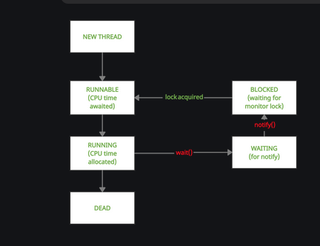

Slide 80
// Java Program to demonstrate usage of wait() and notify()
class demo {
// variable to check if part1 has returned
// volatile used to prevent threads from
// storing local copies of variable
volatile boolean part1done = false;
// method synchronized on this
// i.e. current object of demo
synchronized void part1()
{
System.out.println("Welcome to India");
part1done = true;
System.out.println(
"Thread t1 about to surrender lock");
// notify the waiting thread, if any
notify();
}
// method synchronized on this
// i.e. current object of demo
synchronized void part2()
{
// loop to prevent spurious wake-up
while (!part1done) {
try {
System.out.println("Thread t2 waiting");
// wait till notify is called
wait();
System.out.println(
"Thread t2 running again");
}
catch (Exception e) {
System.out.println(e.getClass());
}
}
System.out.println("Do visit Taj Mahal");
}
}
public class Main {
public static void main(String[] args)
{
// Make an instance of demo class
demo obj = new demo();
// Thread t1 will call part1()
Thread t1 = new Thread(new Runnable() {
public void run() { obj.part1(); }
});
// Thread t2 will call part2()
Thread t2 = new Thread(new Runnable() {
public void run() { obj.part2(); }
});
// Start t2 and then t1
t2.start();
t1.start();
}
}

Slide 81
notifyAll() Method
notifyAll method wakes up all the threads waiting on the object, although which one will process first depends on the OS implementation.

Slide 82
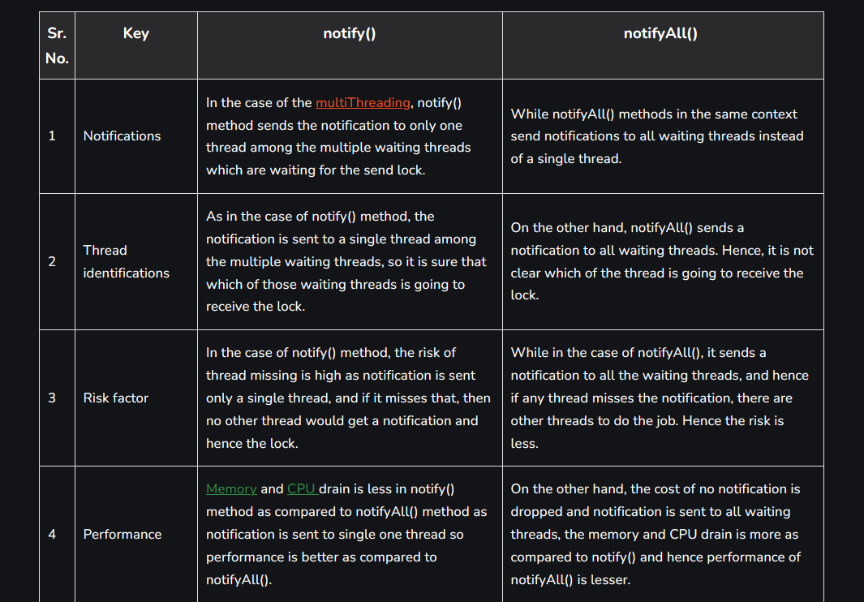

Slide 83
Code using notify
// Java program to illustrate the
// behaviour of notify() method
class Main1 extends Thread {
public void run()
{
synchronized (this)
{
System.out.println(
Thread.currentThread().getName()
+ "...starts");
try {
this.wait();
}
catch (InterruptedException e) {
e.printStackTrace();
}
System.out.println(
Thread.currentThread().getName()
+ "...notified");
}
}
}
class Main2 extends Thread {
Main1 main1;
Main2(Main1 main1){
this.main1 = main1;
}
public void run()
{
synchronized (this.main1)
{
System.out.println(
Thread.currentThread().getName()
+ "...starts");
try {
this.main1.wait();
}
catch (InterruptedException e) {
e.printStackTrace();
}
System.out.println(
Thread.currentThread().getName()
+ "...notified");
}
}
}
class Main3 extends Thread {
Main1 main1;
Main3(Main1 main1) { this.main1 = main1; }
public void run()
{
synchronized (this.main1)
{
System.out.println(
Thread.currentThread().getName()
+ "...starts");
this.main1.notify();
System.out.println(
Thread.currentThread().getName()
+ "...notified");
}
}
}
class MainClass {
public static void main(String[] args)
throws InterruptedException
{
Main1 main1 = new Main1();
Main2 main2 = new Main2(main1);
Main3 main3 = new Main3(main1);
Thread t1 = new Thread(main1, "Thread-1");
Thread t2 = new Thread(main2, "Thread-2");
Thread t3 = new Thread(main3, "Thread-3");
t1.start();
t2.start();
Thread.sleep(100);
t3.start();
}
}

Slide 84
Code using notifyAll()
// Java program to illustrate the
// behavior of notifyAll() method
class Main1 extends Thread {
public void run()
{
synchronized (this)
{
System.out.println(
Thread.currentThread().getName()
+ "...starts");
try {
this.wait();
}
catch (InterruptedException e) {
e.printStackTrace();
}
System.out.println(
Thread.currentThread().getName()
+ "...notified");
}
}
}
class Main2 extends Thread {
Main1 main1;
Main2(Main1 main1){
this.main1 = main1;
}
public void run()
{
synchronized (this.main1)
{
System.out.println(
Thread.currentThread().getName()
+ "...starts");
try {
this.main1.wait();
}
catch (InterruptedException e) {
e.printStackTrace();
}
System.out.println(
Thread.currentThread().getName()
+ "...notified");
}
}
}
class Main3 extends Thread {
Main1 main1;
Main3(Main1 main1) { this.main1 = main1; }
public void run()
{
synchronized (this.main1)
{
System.out.println(
Thread.currentThread().getName()
+ "...starts");
this.main1.notifyAll();
System.out.println(
Thread.currentThread().getName()
+ "...notified");
}
}
}
class MainClass {
public static void main(String[] args)
throws InterruptedException
{
Main1 main1 = new Main1();
Main2 main2 = new Main2(main1);
Main3 main3 = new Main3(main1);
Thread t1 = new Thread(main1, "Thread-1");
Thread t2 = new Thread(main2, "Thread-2");
Thread t3 = new Thread(main3, "Thread-3");
t1.start();
t2.start();
Thread.sleep(100);
t3.start();
}
}

